Slide 1
Writing in the sand

Slide 2
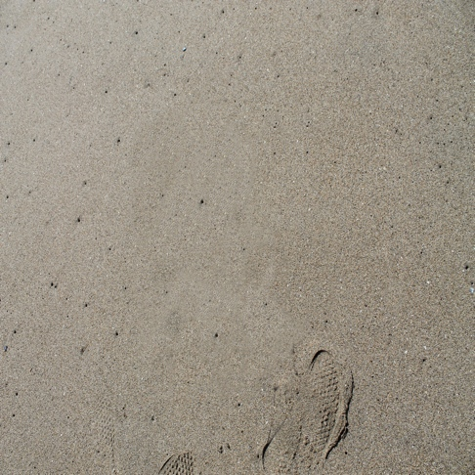
Step 1 & 2
Step 1: Find landscape with sand in the picture.
Step 2: Open the picture in Photoshop.

Slide 3
Steps 3, 4, & 5
Step 3: Make a new blank layer
Step 4: Choose the eyedropper tool
Step 5: choose a color while still in the eyedropper tool

Slide 4
Step 6
Write in the sand

Slide 5
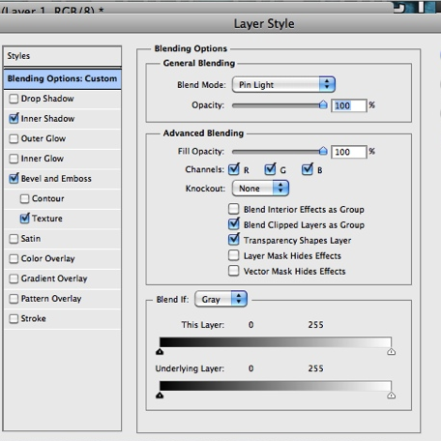
The Blending Options
Blend Mode: Pin Light
Opacity: 100
Fill Opacity: 100

Slide 6
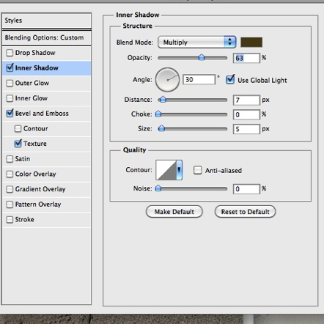
Inner Shadow
Blend Mode: 63
Distance: 7
Choke: 0
Size: 5
Noise: 0

Slide 7
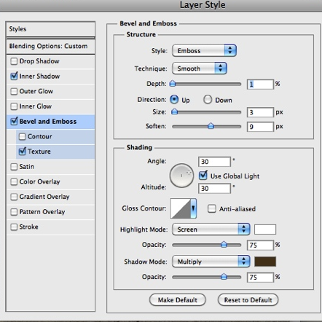
Bevel and emboss
Style: Emboss
Technique: Smooth
Depth: 1
Size: 3
Soften: 9
Highlight and Shadow Mode:
  75

Slide 8
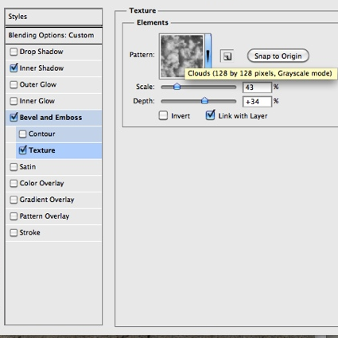
texture
Pattern: Clouds
Scale: 43
Depth: +34

Slide 9

Final Piece
Resize the image to 8x10
Save as a JPG

