Slide 1
Realistic Sand Writing on Photoshop

Slide 2
Use your computer number!
Sign in under Adobe
Password: adobe
Import photos to i-photo
Make a folder for the photos
  Sunny Cove field trip
  Make an ALBUM for the photos you will use: SAND WRITING

Slide 3
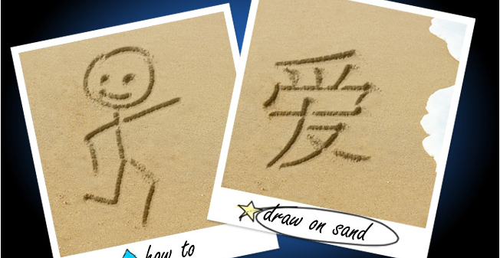
HOW To DRAW On SAND

Slide 4
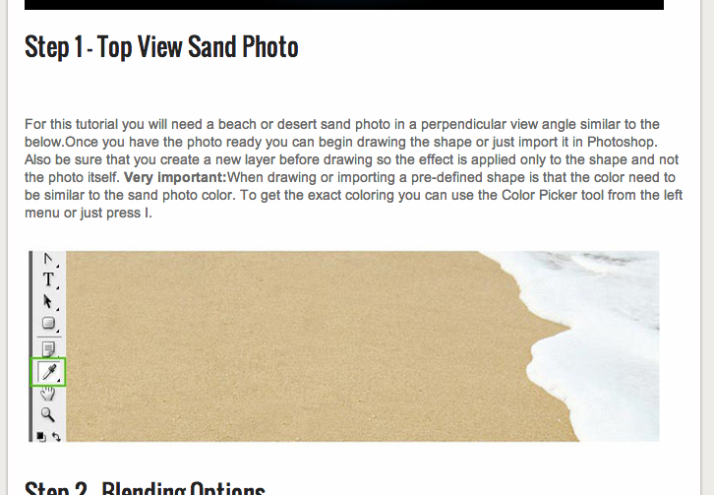
STEP ONE – TOP VIEW SAND PHOTO

Slide 5
Drag and drop your photo into photoshop
Resize the image to an 8 x 10
Create a new layer
Choose the paint color close to the color of the sand where you will be writing
hide the background layer
Draw the picture/words that you want in the sand
Reveal the background layer

Slide 6
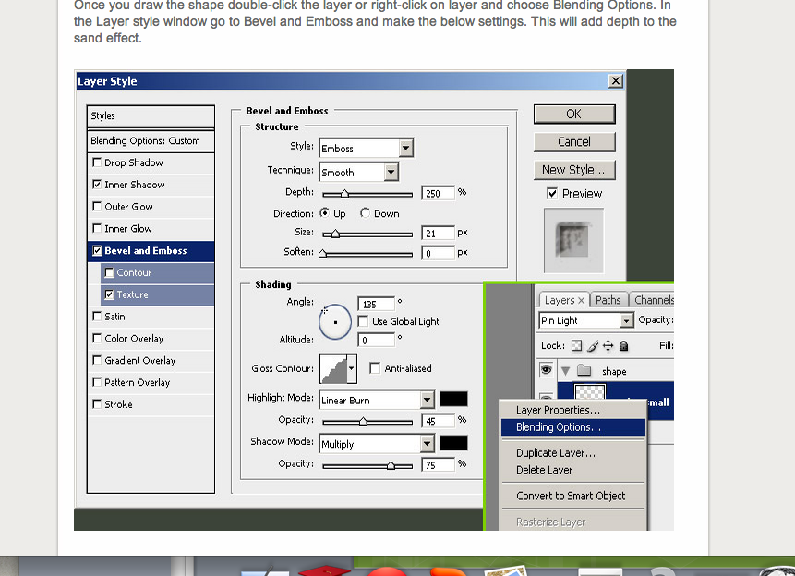
STEP TWO – BLENDING OPTIONS

Slide 7
STEP TWO – BLENDING OPTIONS
STYLE
-Inner Shadow - Altitude: 0 degrees
-Bevel and Emboss - Highlight Mode: Linear Burn
- Texture - Opacity 45%
- Style: Emboss - Shadow Mode: Multiply
- Technique: Smooth - Opacity 75%
- Depth: 250%
- Direction: Up
- Size: 21px
- Soften: 0px
Shading
-Angle:135 degrees

Slide 8
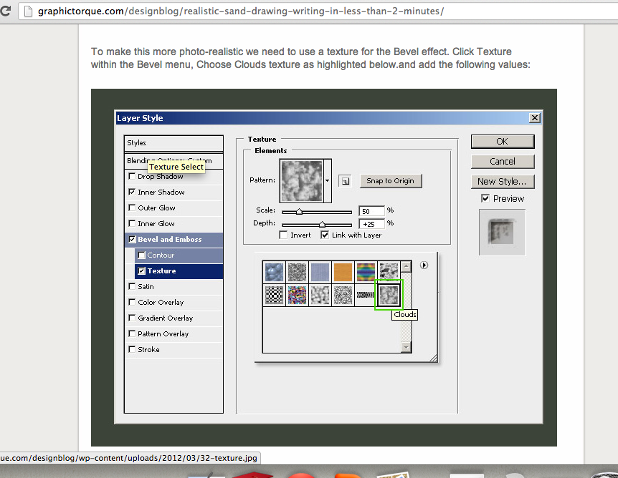
Texture Settings: Cloud

Slide 9
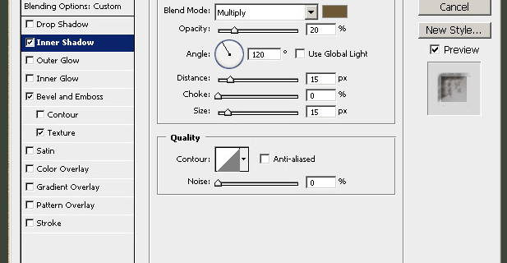
Inner Shadow:

Slide 10
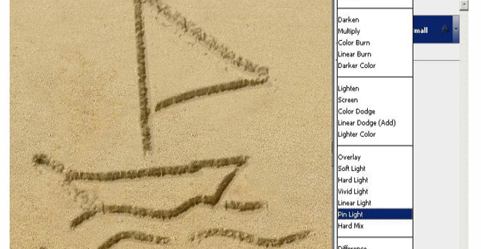
Layers: Pin Light

Slide 11
FINALIZE & PUBLISH!
Retouch the adjustments until they look the best
Flatten your layers!
Post your PRE and POST photos on your website
Email the link to:
  lrankin@losd.ca
  NOW, WORK ON EDITING OTHER PHOTOS

