Slide 1
Representation
Symbolism in Art
& the Dada movement of the early 1900s

Slide 2
What does this represent?

Slide 3
What does this represent?

Slide 4
What does this represent?

Slide 5
What does this represent?

Slide 6
What does this represent?

Slide 7
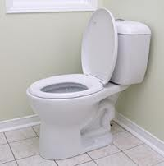
What does this represent?

Slide 8
What does this represent?

Slide 9
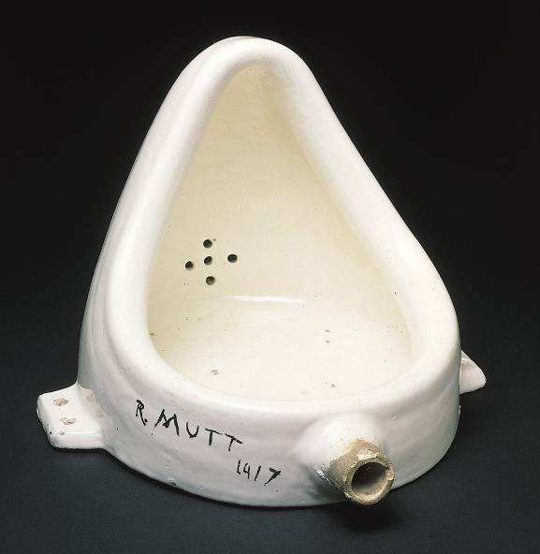
MARCEL DUCHAMP, Fountain, (second version), 1950 (original version produced 1917)*. Readymade glazed sanitary china with black paint, 1’ high. Philadelphia Museum of Art, Philadelphia.
--Considered a “ready made” (found art)
--Signature a play on words with the French plumbing company, R. Mott
--It was rejected from an avant-garde exhibit (he resigned from the group)
-- Challenges traditionally –conceived understandings of art
-- “anti-art”: ready-mades – using a pre-existing object presented in a light that inspires new ideas/deeper meaning

Slide 10
Effects of WWI on Europe
Lots a LOT of men from one generation due to warfare
Men returning suffered “shell shock” (post-tramatic stress)
This generation is known as the “lost generation” because of almost 10 million men who died
Disillusioned of humanity because of what transpired during WWI
The progressive spirit turns to cynicism

Slide 11
Dada begins, by most accounts, in 1916 in Zurich.
It was a reaction against:
The modern world with Its radical disruptions and transformations.
The violence and waste of World War I.
The notion of the artist as “master” of his medium.
They insisted upon the use of the “stuff” of modern life, ready-made objects, newspaper articles, urinals, ticket stubs, advertisements, and the ubiquitous light bulb in creating their art.
They did not see art as a “transcendental experience” or a mastery of some subject (or object), but as a way of making visible the hypocrisies, deceptions, violence, and chaos of the modern age.
In the words of Hugo Ball: “For us, art is not an end in itself . . . But it is an opportunity for the true perception and criticism of the times we live in.” (Flight out of Time: A Dada Diary. Entry April 5, 1916.)

Slide 12
Dada Art Philosophies
Artists protested society’s demise (as seen in WW1) by refusing to participate in traditional artistic mediums.
They were saying, “We will not have any part in society’s traditions, including society’s artistic traditions.”
Dada art is satirizing society’s ineptness – if society can be nonsensical; so can art…

Slide 13
DADA
Dada artists believed that traditional society supports (law, faith, culture, economy, etc) failed to prevent WWI
So, they declared a “war” on tradition and criticized formal institutions and conventional art
Instead they expressed ABSURDITY, SPONTANEITY, and FREE WILL—not just to shock but for imagination
Dada= random selection from a dictionary—means “rocking horse” in French—founded in Zurich, Switzerland
Would use the word in their art pieces
Used new methods, materials, and technologies
COLLAGE, PHOTOMONTAGE, and ASSEMBLAGE
Influenced: Romare Bearden (collagist), Robert Rauschenberg, and Louise Nevelson

Slide 14
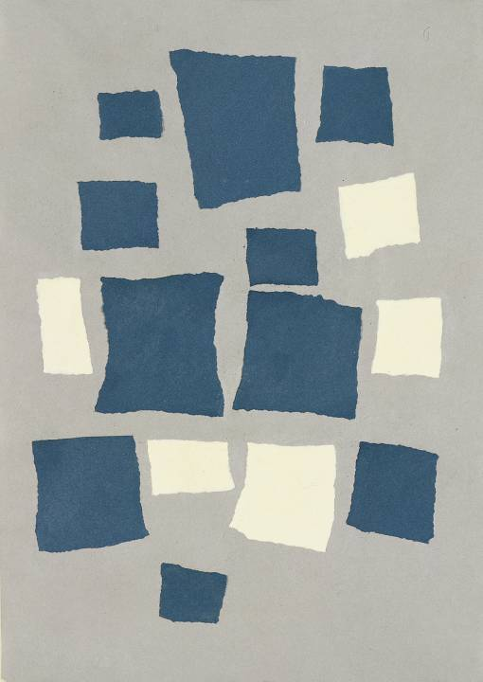
JEAN (HANS) ARP, Collage Arranged According to the Laws of Chance, 1916–1917*. Torn and pasted paper, 1’ 7 1/8” x 1’ 1 5/8”. Museum of Modern Art, New York. --worked with his wife to create collages that looked like her abstract textiles --Interested in the subconscious (this will also be part of Surrealism) --Using chance is avant-garde!

Slide 15
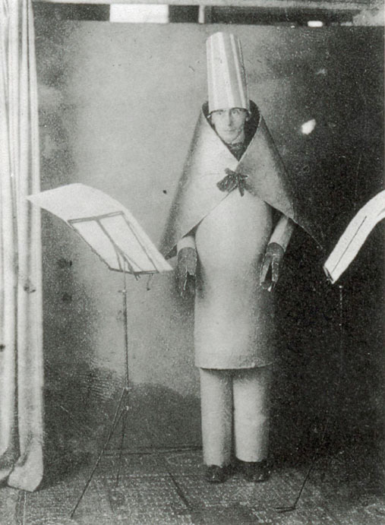
The Cabaret Voltaire was the birthplace of Dada. Hugo Ball established the café to provide a space for he and his friends to stage their Dada activities.
These friends included the singer Emmy Hennings, and other artists and writers such as Hans Arp, Marcel Janco, Tristan Tzara, and Richard Huelsenbeck.
Hugo Ball, performing his sound poem 'Karawane' at the Cabaret Voltaire (June 23, 1916):

Slide 16
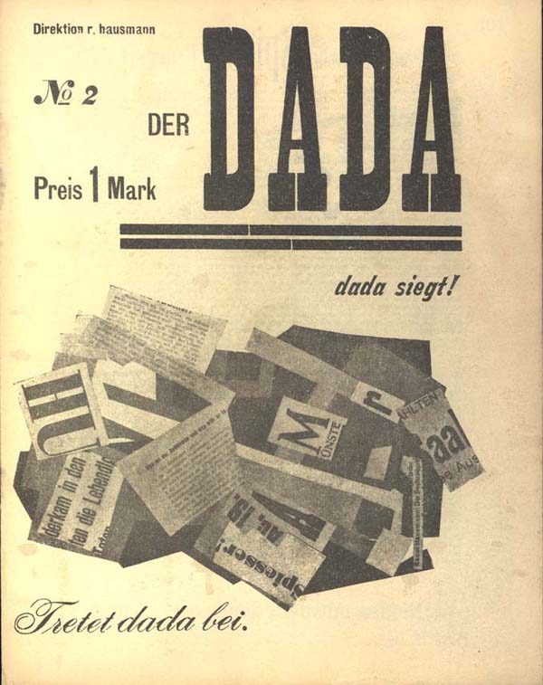
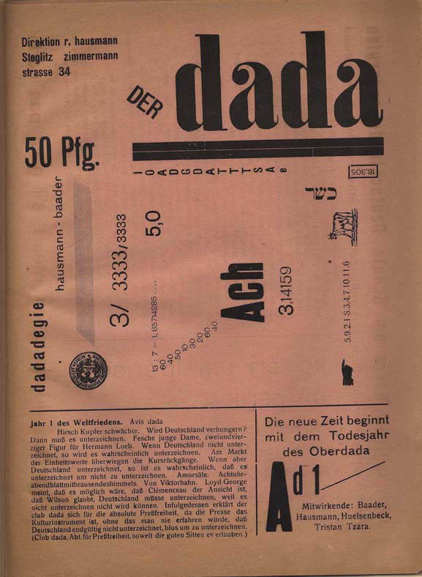
Ball announced that one of their aims would be to publish a “Dada” journal.

Slide 17
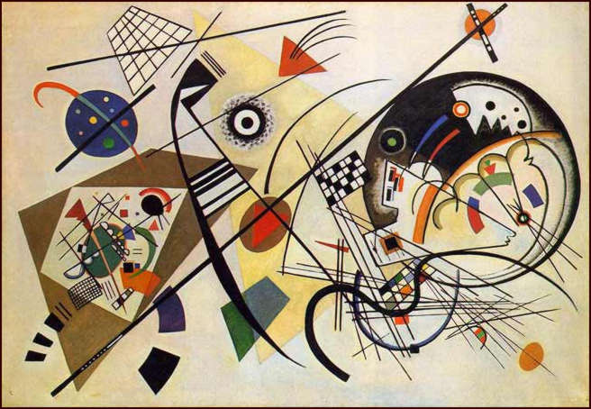
They were very impressed by the work of Kandinsky.

Slide 18
Wassily Kandinsky (1866-1944) Transverse Line, 1923 141 x 202 cm Oil on canvas Kunstsammlung Nordrhein-Westfalen, Dusseldorf
For these early Dadaist, such as Huelsenbeck, Abstract Art “signified absolute honesty.” (En Avant Dada, 1920.)

Slide 19
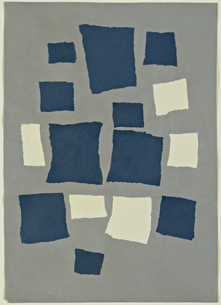
Arp wanted to push this form of abstraction further, trying to think of ways to eliminate artistic choice. He believed that rational thought had led to WW I, so he wanted to get as far from that as possible. He looked for ways to make chance central to the development of artistic works.
Untitled (Collage with Squares Arranged according to the Laws of Chance)
Jean (Hans) Arp (French, born Germany (Alsace). 1886-1966)

Slide 20
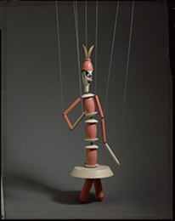
They also tended to idolize what they saw as “primitive”—non-Western art, ancient ritual, pre-linguistic noises, children’s art, and unconscious expressions.
Sophie Taeuber. Swiss, 1889–1943
Freud Analytikus (Freudian Analyst), 1918 turned, painted wood, brass ornament, and metal joints

Slide 21
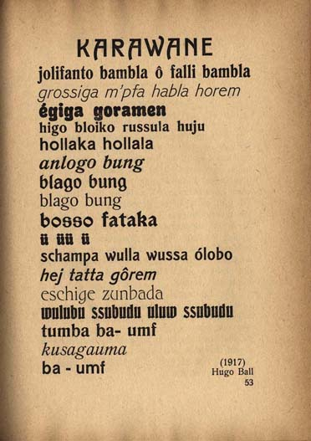
Hugo Ball’s “sound poem,” Karawane, works in a similar way:
When Ball became exhausted by his activities, and the owner of the building in which Café Voltaire had been established demanded more mainstream, revenue-generating material, Tristan Tzara became the new leader of the Dada movement.

Slide 22
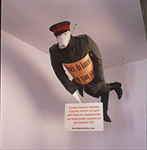
In 1917 Richard Huelsenbeck returned to Berlin and founded the Club Dada. He was joined by like-minded artists including George Grosz, John Heartfield, Raoul Hausmann, and Hannah Höch.
John Heartfield and Rudolf Schlichter
Preussischer Erzengel (Prussian Archangel), 2004 (reconstruction of lost 1920 original) papier-mâché (pig's head); wire mesh (body); palm grass, hemp, and horse hair (filling); uniform cut from field gray material, following original pattern; World War I field cap, boots, and shoulder lapels; woodcut (signs)

Slide 23
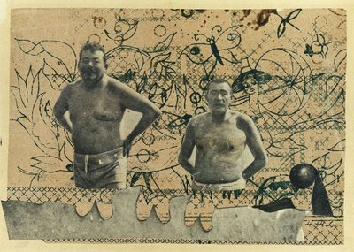
They also invented the photo montage:
Hannah Höch: “Heads of State,” 1918–1920

Slide 24
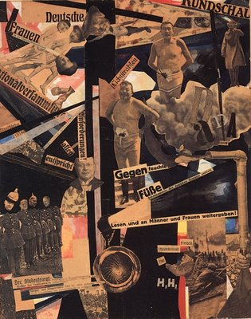
Hannah Höch: Dada Rundschau (Dada Review, 1919)

Slide 25
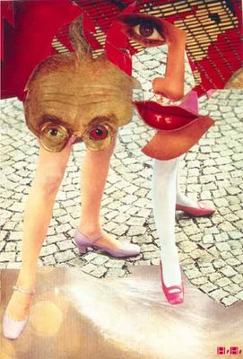
Hannah Höch: Grotesque (1963)

Slide 26
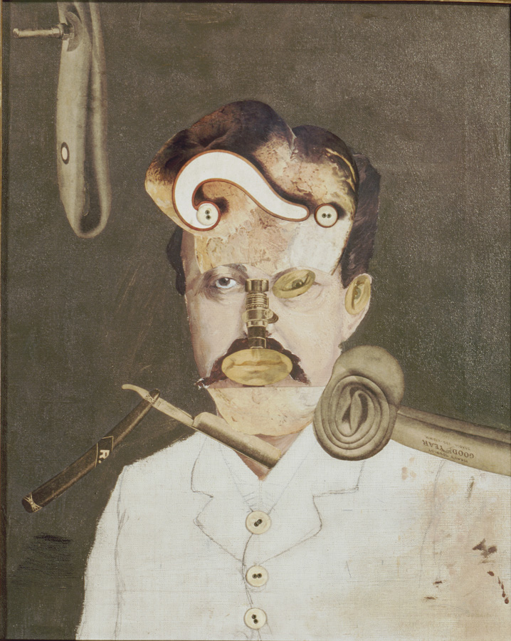
George Grosz (American, born Germany. 1893-1959).
A Victim of Society (Ein Opfer der Gesellschaft), 1919

Slide 27
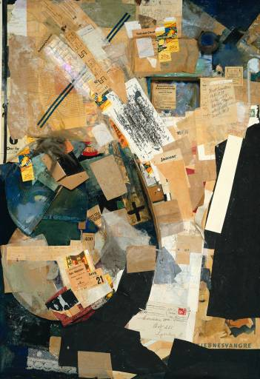
In Hannover, Kurt Schwitters was developing Dada ideas using collages filled with the detritus of modern life. He called this “Merz” from Kommerz, but also Schmerz (pain) and merde (shit, French).
Kurt Schwitters. Picture with Spatial Growths (or Picture with Tww Small Dogs). 1920 and 1939, Assemblage.

Slide 28
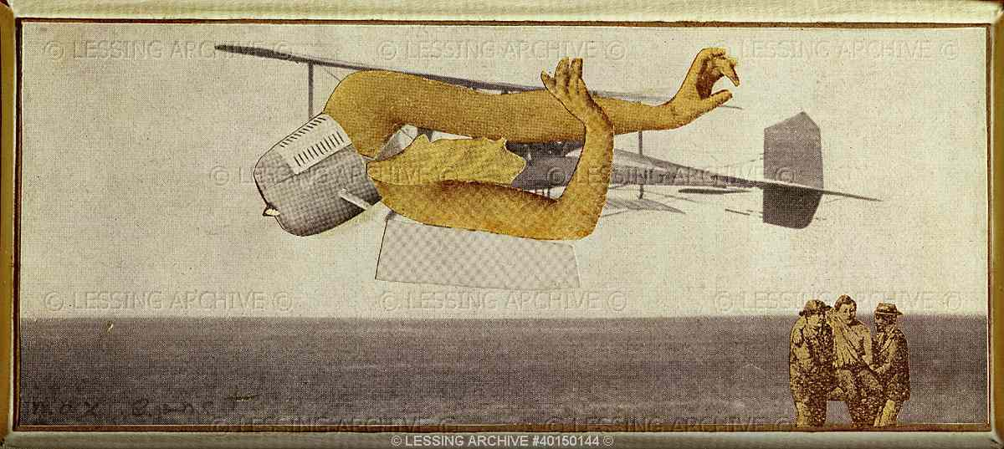
In 1919 the Treaty of Versailles place Cologne under German control; this created a space for Dada reaction, led by Max Ernst.
Ernst,Max
Ohne Titel (L'avion meurtrier)- Untitled (murderous air- plane)
Photographic collage (1920)D.& J.de Menil Collection, Houston,Texas, USA

Slide 29
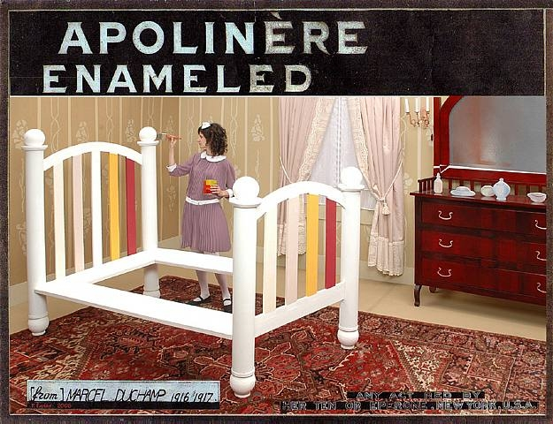
In New York, American artists and European refugees create another vibrant Dada scene.
Created from a Sapolin Enamel advertisement.
Marcel Duchamp, Apolinère Enameled, 1916-1917, rectified readymade: gouache and pencil on painted tin mounted on board.

Slide 30
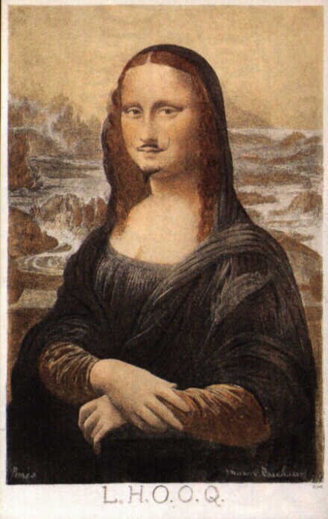
With the war over, Paris, in 1920, became a center for Dada, with Arp, Ernst, Duchamp, Picabia, Tzara, and Man Ray all finding this a fertile ground for expression.
L.H.O.O.Q.
“Elle a chaud au cul”
Marcel Duchamp. 1919. rectified readymade: pencil on reproduction.

Slide 31
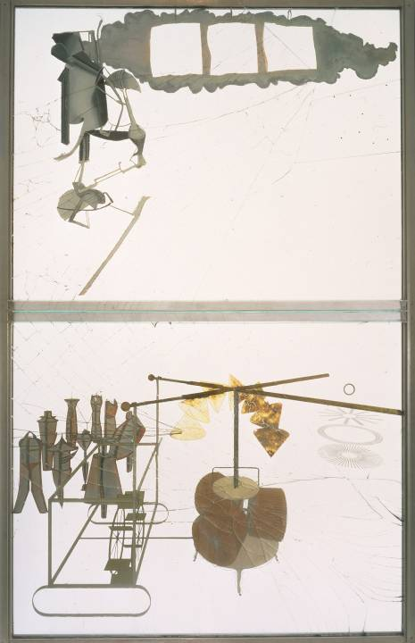
MARCEL DUCHAMP, The Bride Stripped Bare by Her Bachelors, Even (The Large Glass), 1915-23*. Oil, lead, wire, foil, dust, and varnish on glass, 9’ 1 1/2” x 5’ 9 1/8”. Philadelphia Museum of Art, Philadelphia --examines humans as machines --top: a motor fueled by “love gasoline” In 1927, it was being transported and the glass shattered. Duchamp then declared it finished!

Slide 32
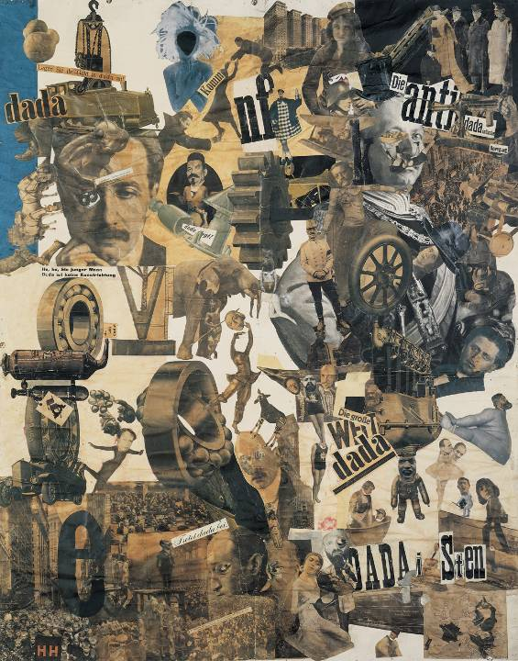
HANNAH HÖCH, Cut with the Kitchen Knife Dada through the Last Weimar Beer Belly Cultural Epoch of Germany, 1919–1920*. Photomontage, 3’ 9” x 2’ 11 1/2”. Neue Nationalgalerie, Staatliche Museen zu Berlin, Berlin. --FOUND images --political Dada --Deliberately random --Dadaists, Marx, Lenin, and herself

Slide 33
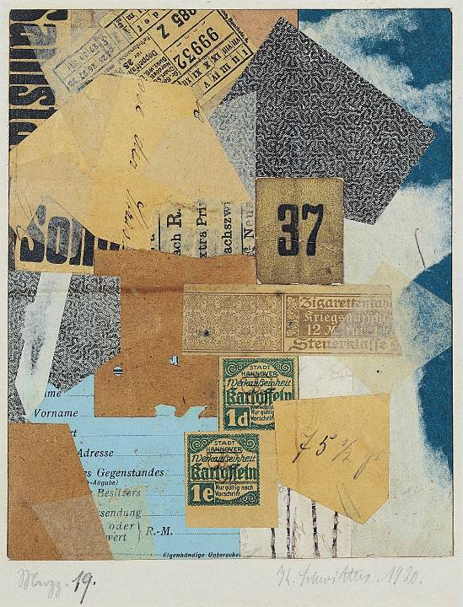
KURT SCHWITTERS, Merz 19, 1920*. Paper collage, 7 1/4” x 5 7/8”. Yale University Art Gallery, New Haven --Inspired by Cubists --scavenged trash bins (elevating trash into art!)

Slide 34
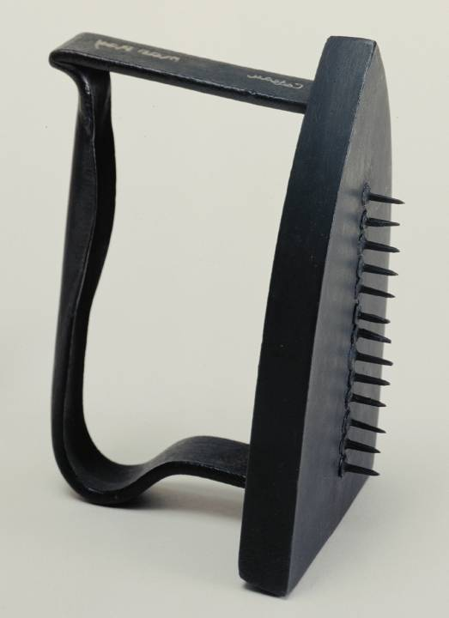
MAN RAY, Cadeau (Gift), ca. 1958 (replica of 1921 original)*. Painted flatiron with row of 13 tacks with heads glued to the bottom, 6 1/8” x 3 5/8” x 4 1/2”. Museum of Modern Art, New York --Humor in art!

Slide 35
Discussion
http://vimeo.com/44601540
What is art for art’s sake?
Is art about a skill or an idea?
Why do people create art that goes against conventional ideas?
Why do new art movements form?
Is “Fountain” art?

