Slide 1
Photoshop Magic!
Techniques for doing incredible things in Photoshop CS5

Slide 2
Text in Photoshop
One of the simpler things to do in PS, you have control over position, opacity, color, and font. Cannot be re-edited once clicked out of the text box.

Slide 3
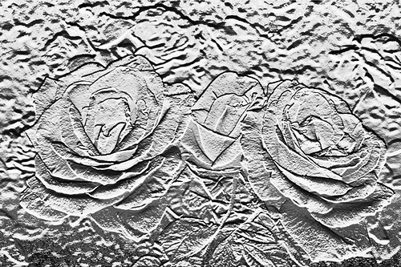
Bas Relief
Two Methods:
1) Use the Bas Relief filter.
2) Use multiple layers and Adjustments.

Slide 4
Border Effects
Extend canvas to add black border
Use pastel medium brush eraser to erase outer edges and create interesting-looking border

Slide 5
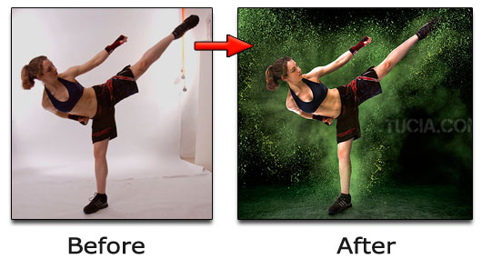
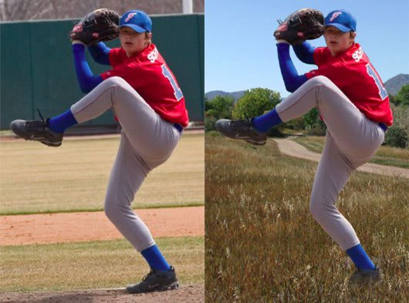
Changing the Background
Duplicate layer
Use magic wand to trace subjects
Open image with bg and select preferred section
Paste selection onto original picture
Change blending mode of bg from Normal to Multiply to fill in white spaces

Slide 6
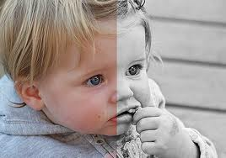
Color Black to White
1) Convert image to grayscale
2) Desaturate
Change mode to Lab Color

Slide 7
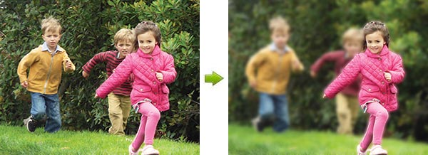
Depth of Field Effect
Use lasso tool to isolate subject
Use Gaussian Blur
Make larger selection around subject, apply more Gaussian Blur
Make even larger selection, apply more Gaussian Blur

Slide 8
Grain Filter
Add noise
Use Grain Filter
Duplicate image and adjust opacity

Slide 9
Hand-coloring
1) Select as much of subject area as possible
2) Use quick mask (everything around selected will turn red)
3) Brush away mask with soft brush
4) Switch off quick mask
5) Adjust hue/saturation till you get the color you want

Slide 10
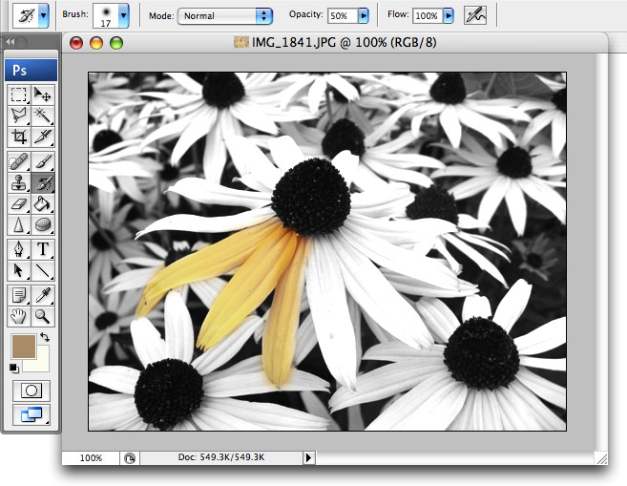

Slide 11
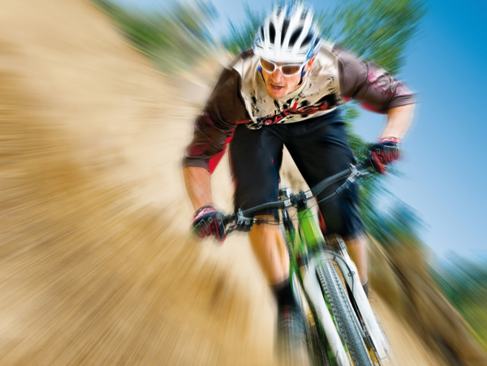
Movement with Radial Blur
Apply low motion blur to whole image
Lasso subject, select inverse
Use motion blur
Lasso “moving” part of subject, apply Radial Blur

Slide 12
Panorama
Scan all prints to same size and resolution
Open photomerge
Manually adjust/crop uneven or awkwardness in joined pictures

Slide 13
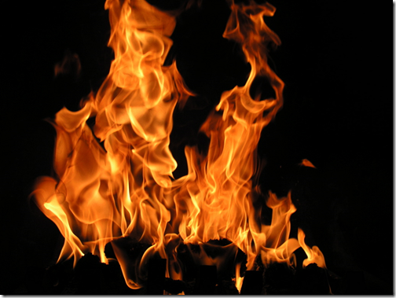
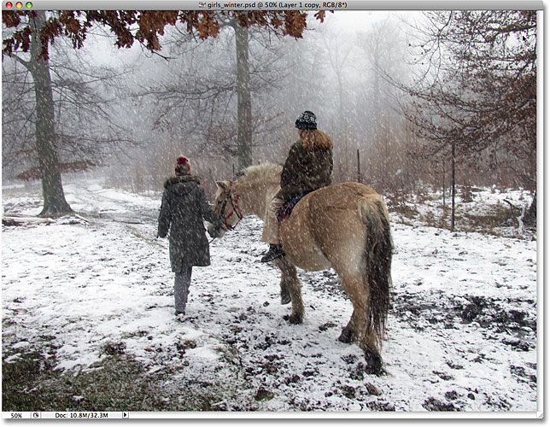
Fire and Snow Fire is complicated, snow is fairly easy.
Fire
Snow

Slide 14
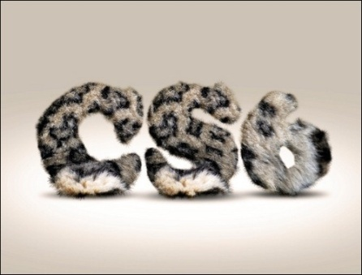
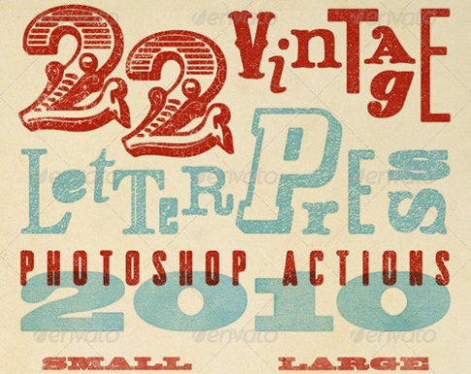
Text Effects
Multitude of effects and methods to create unique text effects.

