Slide 1
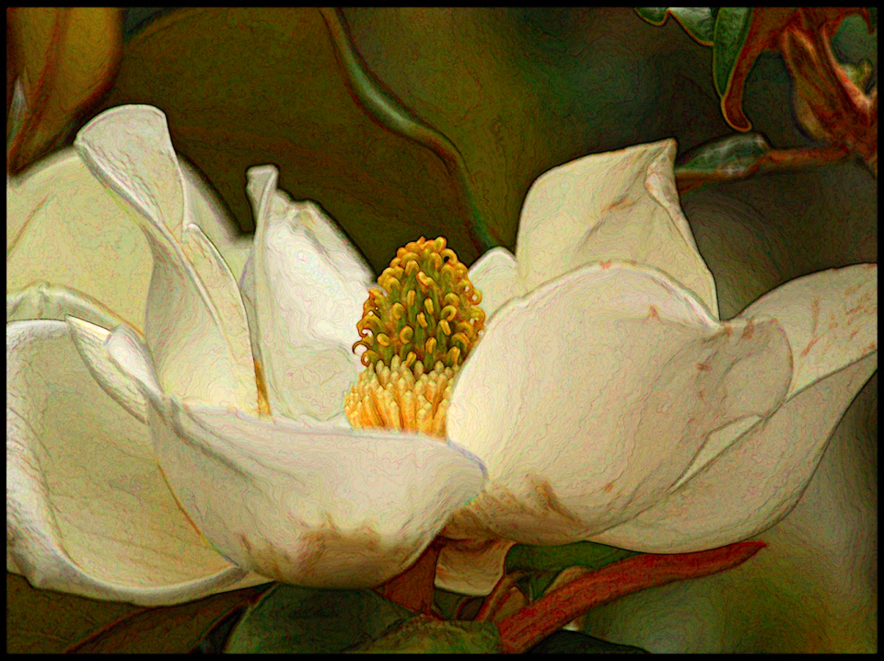
Best Photoshop Filters

Slide 2
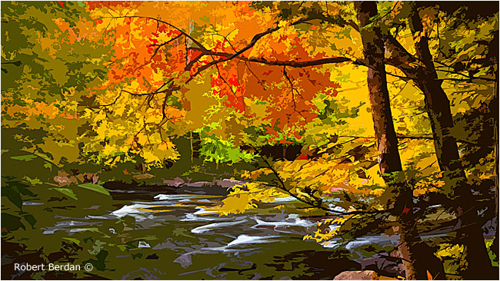
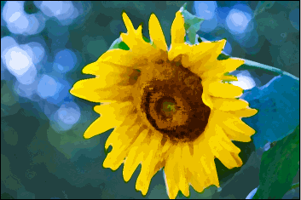
Filters > Artistic

Slide 3
Artistic > Cutout
Reduces number of colors in a photo by merging adjacent similar colors into areas so that they look like pieces of cut-out paper.

Slide 4
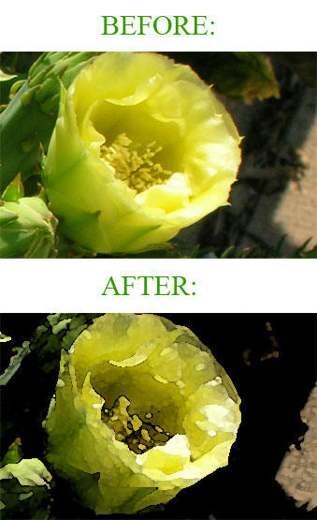
Artistic > Watercolor
Slightly darkens edges of each patch of color imitates look of gouache painting.

Slide 5
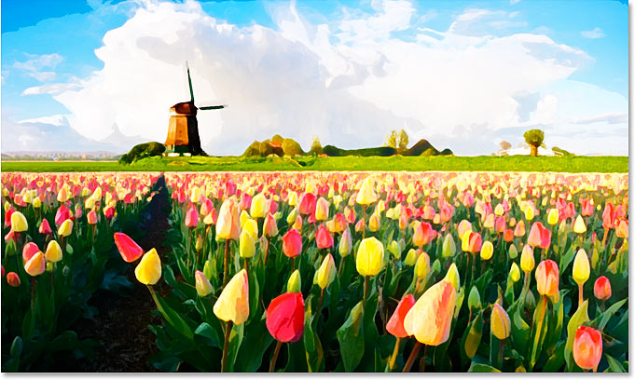

Slide 6
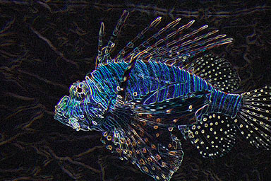
Artistic > Neon Glow
Two-step filter. The effect will be black and white at first.
Enter the Glow Color panel to choose neon color.

Slide 7
Filters > Blur

Slide 8
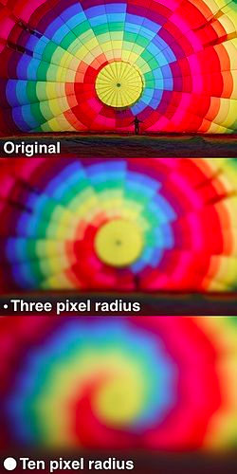
Blur > Gaussian Blur
Adds averaged pixels along edges around and outside of the “search radius.”

Slide 9
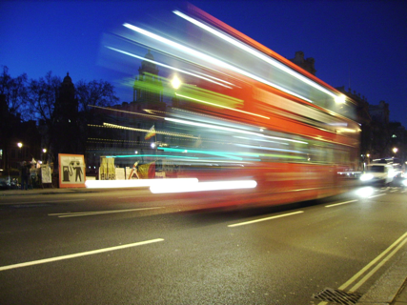
Blur > Motion Blur
Creates blur that can be modified by direction and distance tools.

Slide 10
Blur > Radial Blur
Creates a spin or zoom blur effect around a central point.

Slide 11
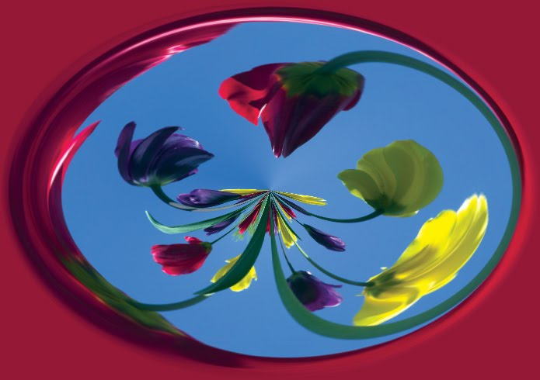
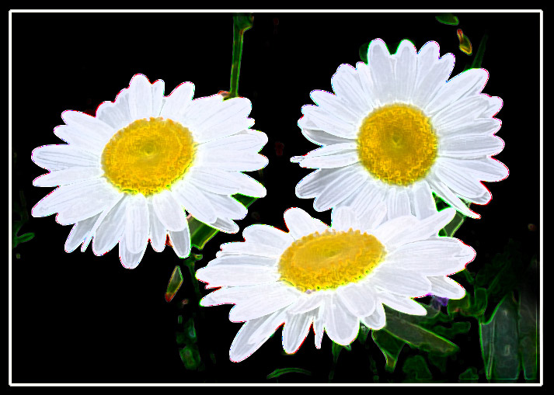
Filters > Distort

Slide 12
Distort > Ocean Ripple
Overlays random pattern over the picture.

Slide 13
Distort > Diffuse Glow
Adds a soft glow to the picture, more on the background than on the subject.
Highlight color can be changed in Toolbox Palette.
Popular in portraits.

Slide 14
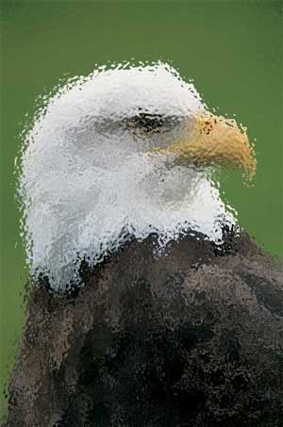
Distort > Glass
Overlays polygon—usually hexagonal—pattern over picture

Slide 15
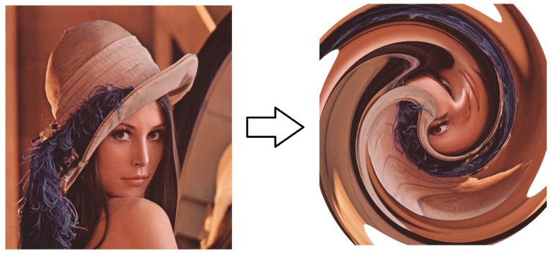
Distort > Twirl
Spins and smears picture. Positive angles on the slider give a clockwise swirl. Negative angles give counter-clockwise swirl.

Slide 16
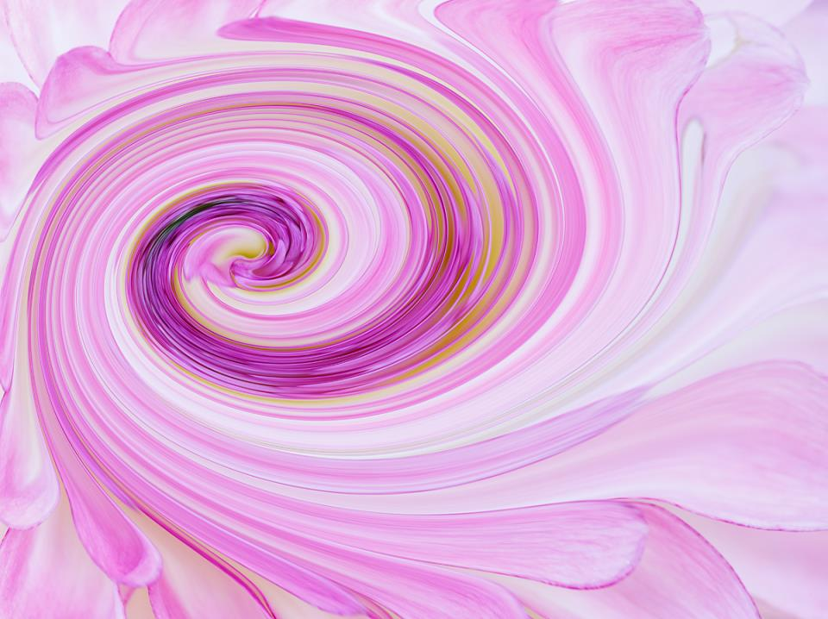

Slide 17
FILTER > NOISE

Slide 18
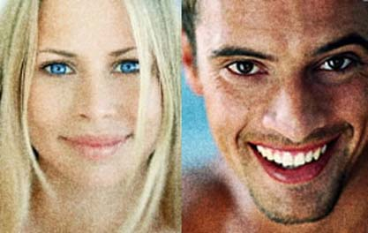
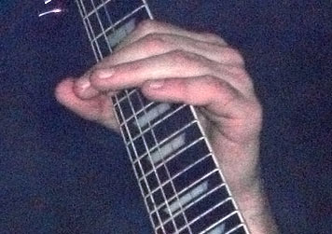
Noise > Add Noise
Gives “natural look” to picture
Overlays black and white specks onto picture
Size of grains can be increased or decreased.

Slide 19
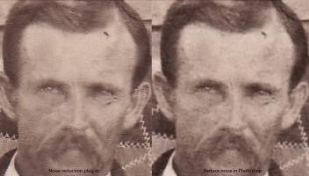
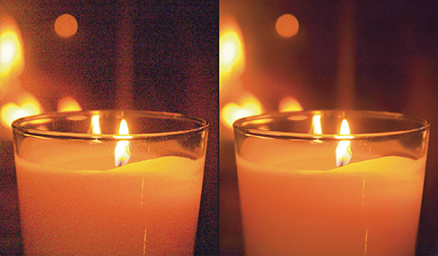
Noise > Reduce Noise
Cleans up block-like artifacts resulting from JPEG compression and underexposure

Slide 20
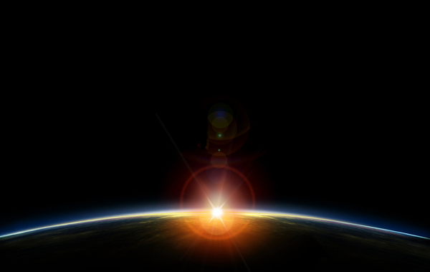
Filter > Render

Slide 21
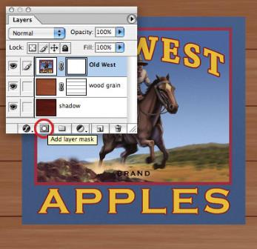
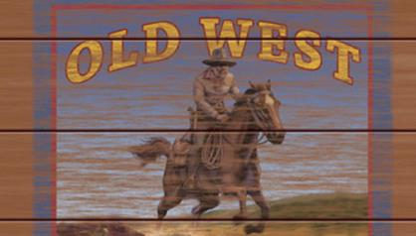
Render > Fibers
Takes back- and foreground colors to produce a random pattern. Contrast and spread can be controlled with Variance slider. Striation can be controlled with Strength slider.

Slide 22
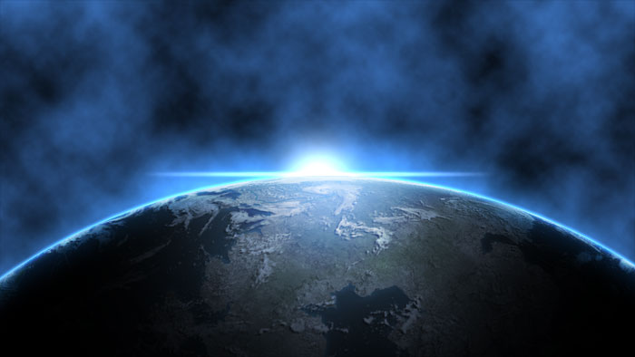
Render > Clouds
Overlays mottled pattern over picture. Size and color of clouds can be controlled.
Clouds are often a step in making a more complex effect.

Slide 23
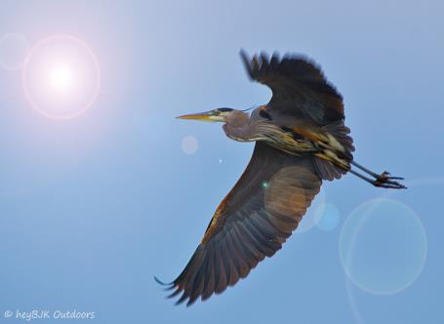
Render > Lens Flare
Adds a typical-looking lens flare effect
Position and angle, lens flare, and brightness can be controlled.
Position of sun should match up to the lighting and shadow in picture.

Slide 24
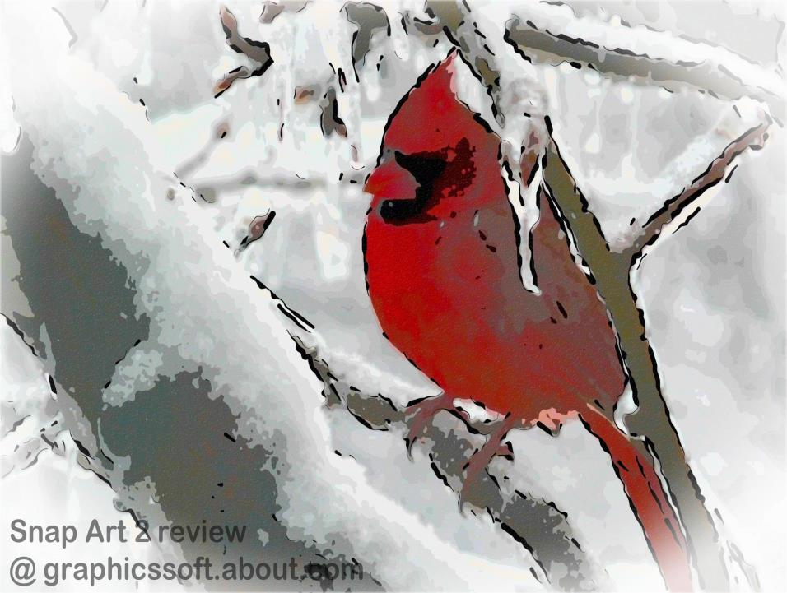
Filter > Stylize

Slide 25
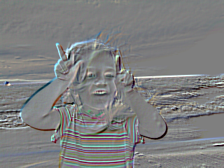
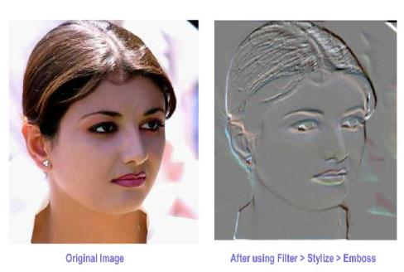
Stylize > Emboss
Gives metallic and engraved look to picture.

Slide 26
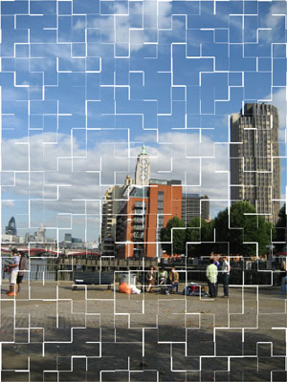
Stylize > Tiles
Overlays horizontal and vertical lines that resemble the edges of mosaic tiles.
Number/size and “neatness” of tiles can be controlled

Slide 27
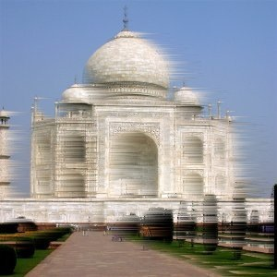
Stylize > Wind
Gives impression of movement to static image

Slide 28
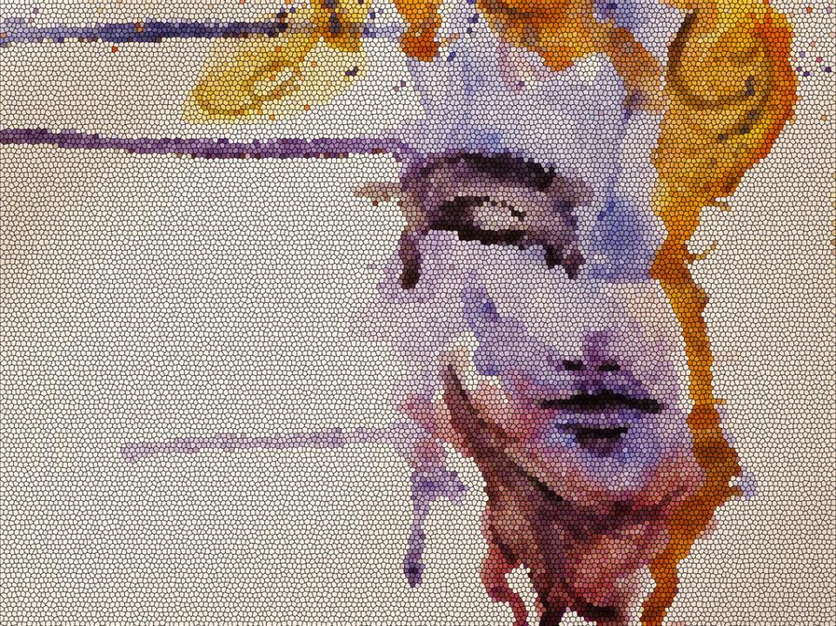
These are just a few of the more popular filters, but,
there are a LOT more in Photoshop.

