Slide 1
Logical Fallacies
Errors in reasoning
Faulty logic
Unjustified arguments

Slide 2
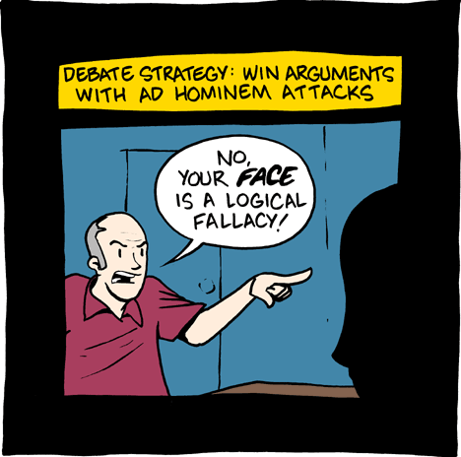
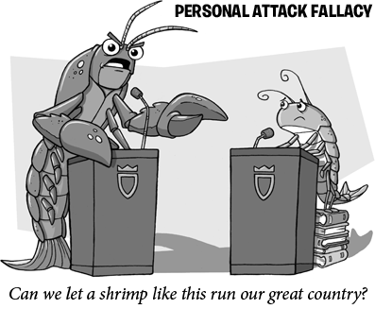
Ad Hominem/Personal Attack
http://www.youtube.com/watch?v=EJKlB_FuOTE
Attacking the person rather than the argument

Slide 3
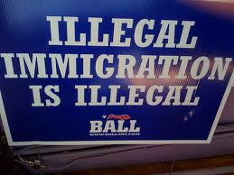

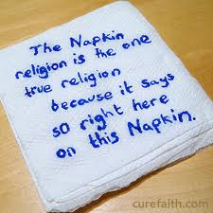

Circular Reasoning
The conclusion is used as the premise.
Student: I don’t want to do the assignment, so I shouldn’t have to.

Slide 4
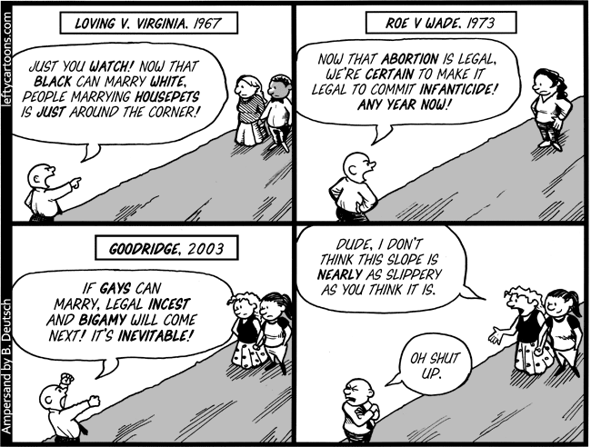
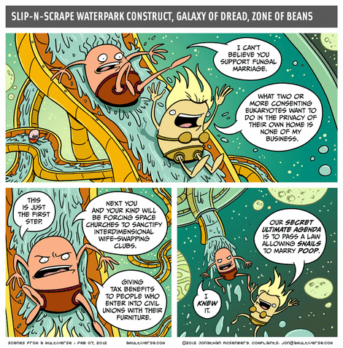
Slippery Slope
One action will lead to another unacceptable action. If X, then eventually Z.
http://www.youtube.com/watch?v=6TiXUF9xbTo

Slide 5
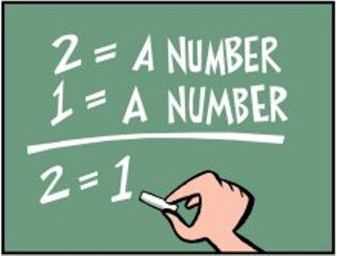
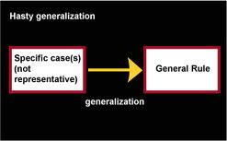
Hasty Generalization
A point made with insufficient evidence.
EX: I saw 5 people drinking at the party so everyone there was drunk.

Slide 6
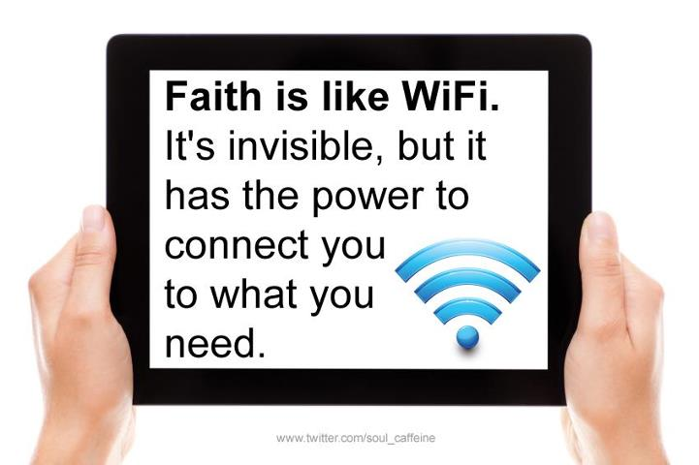
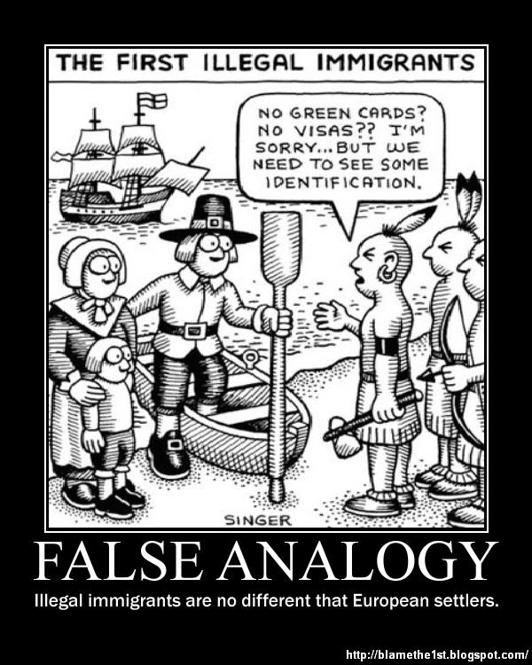
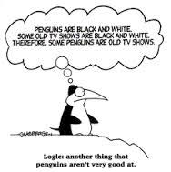
False Analogy: Compares 2 situations that are not comparable

Slide 7

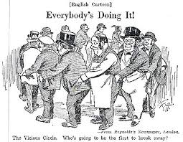
Bandwagon
Tries to engage you because it is the popular choice
“Everyone’s doing it!”

Slide 8
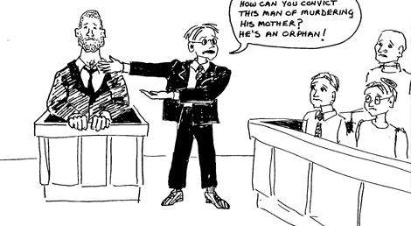
Ad Misericordiam: Appeal to Emotions

Slide 9
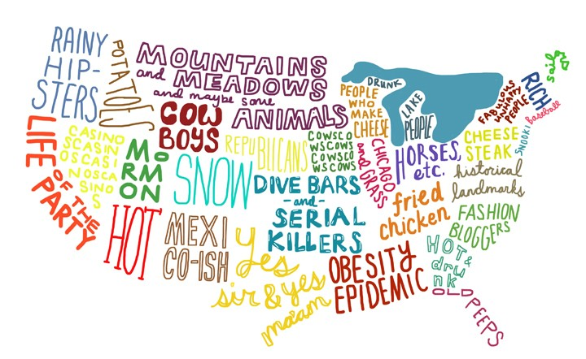
Loose Generalization
Argument based on stereotypes
http://www.youtube.com/watch?v=jbc2NaLuv1A

Slide 10
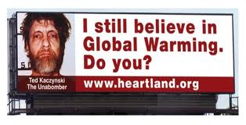
Loose Generalization
Argument based on stereotypes. Because there is one common factor, all factors are congruent.
http://www.youtube.com/watch?v=jbc2NaLuv1A
EX: I saw him hanging out with the druggie kids, so he must do drugs as well. She has short hair so she must be a lesbian.

Slide 11
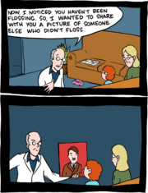
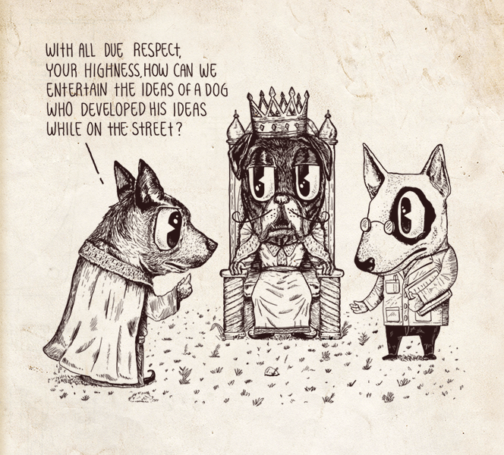
Genetic Fallacy
He is a gypsy, therefore he is a thief
The Volkswagon Beetle was originally made by the Nazi’s therefore, this car is evil

Slide 12
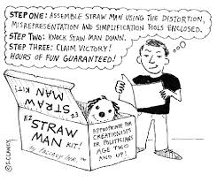
Straw Man

Slide 13
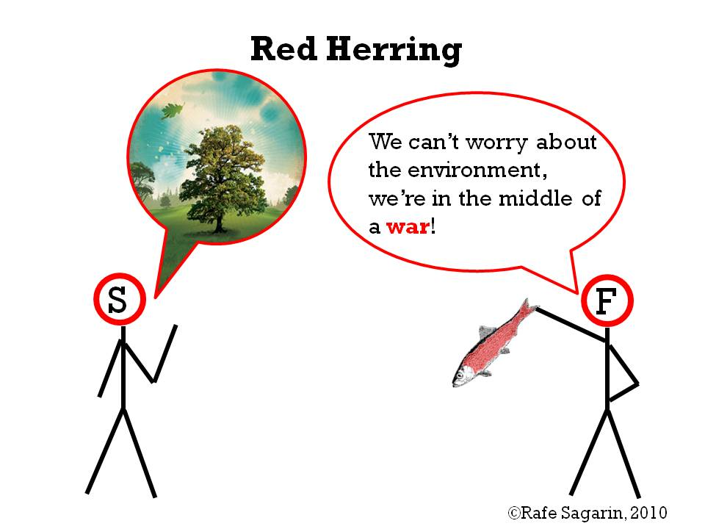
Red Herring
Distracting from the argument by using an off-topic remark or question

Slide 14
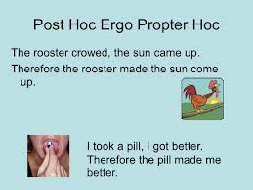
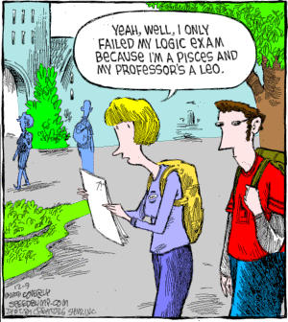
Single Cause and Effect
A mistake that assumes that anything that came before that event caused that event to happen

Slide 15
Stacking the Deck
The speaker ignores the examples that support the other side of the argument, and lists examples that only support their own argument.
EX: Global Warming is not happening. Climate change happens naturally over time. Haven’t you noticed that the weather changes over time?

Slide 16
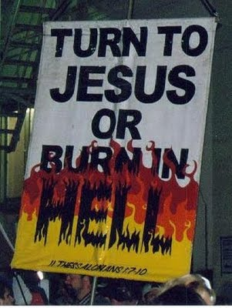
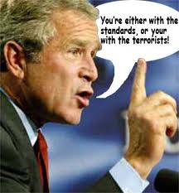
Either/Or
An argument that presents an artificially limited range of choices.

Slide 17
Overgeneralization
Arguments that oversimplify reality.
http://www.youtube.com/watch?v=PJKAr1r5zlA
“It’s the best!”
“It’s the worst!”
“No one likes it.”
“Everyone who listens reggae music smokes weed. Everyone who listens to punk music is an anarchist.”

Slide 18
False Authority
Source is not a credible source for the topic at hand
My mom/friend/brother said ______, so it must be true.
http://www.youtube.com/watch?v=7ud3pK5Wa90

Slide 19

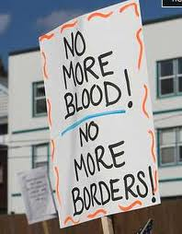
Non Sequitur
Conclusion doesn’t follow the original argument

